Slide 1
Modeling Human Perceptual Decision-Making and Bias
Disconnected Connectionists (DC)

Slide 2
Roadmap to Our Project Presentation
Project Goals
The Laquitaine & Gardner Dataset

Slide 3
Goals
Immediate Goals
Analyze how past trials affect current motion estimation errors.
Test whether perceptual biases exist.
Develop online Bayesian model
Overall Goals
Model perceptual decision-making under uncertainty & understanding human perception through experience and feedback

Slide 4
The Laquitaine & Gardner Dataset
Motion direction estimation task
12 human subjects
83,214 behavioral trials
What you SEE (sensory evidence) vs. What you EXPECT (prior knowledge)
data01_direction4priors experiment

Slide 5
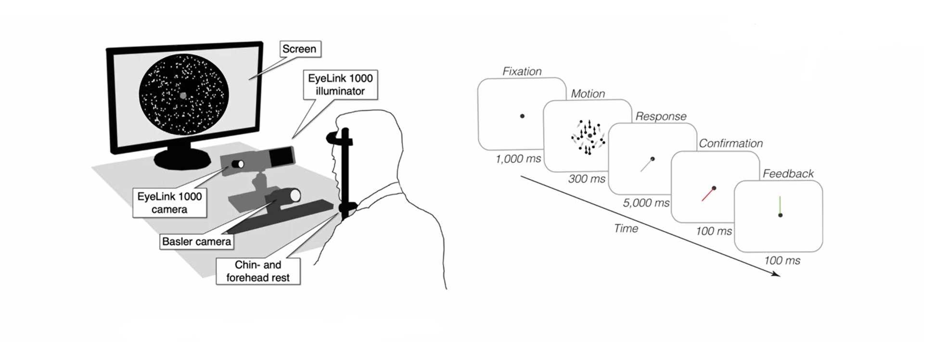
The Laquitaine & Gardner Dataset
Illustration from Nystrom, et al., Behav Res (2023) Laquitaine Presentation, “Projects Dataset: Bayes heuristics” https://www.youtube.com/watch?v=NYzgpUtBhPM

Slide 6
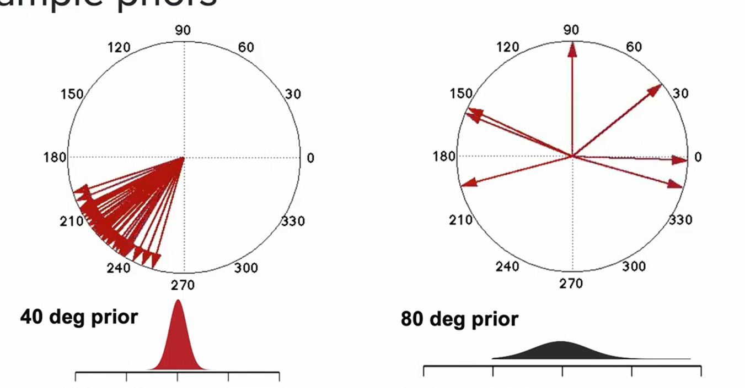
The Laquitaine & Gardner Dataset
Laquitaine Presentation, “Projects Dataset: Bayes heuristics” https://www.youtube.com/watch?v=NYzgpUtBhPM

Slide 7
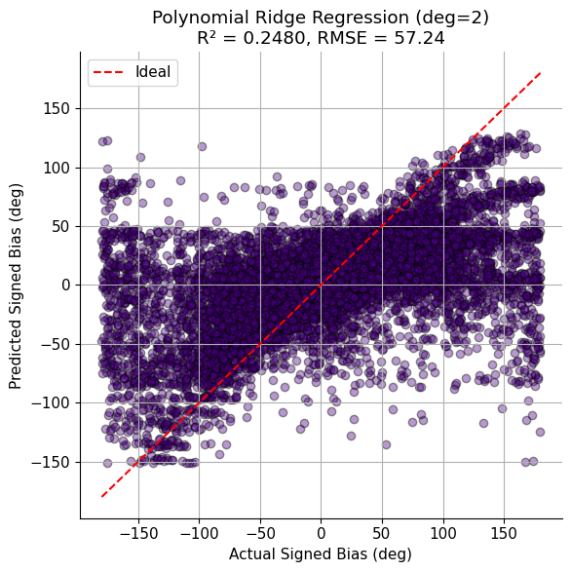
Predicting Signed Bias from Priors
Predicting the angular difference between the subject’s estimate and the true prior direction.
A positive value = estimate is clockwise from the prior
A negative value = estimate is counter-clockwise from the prior

Slide 8
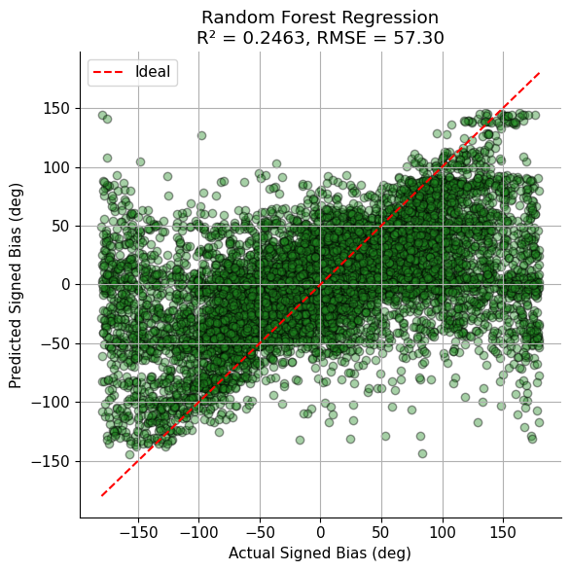
Predicting Signed Bias from Priors
Both models show moderate predictive performance (R² ≈ 0.25)

Slide 9
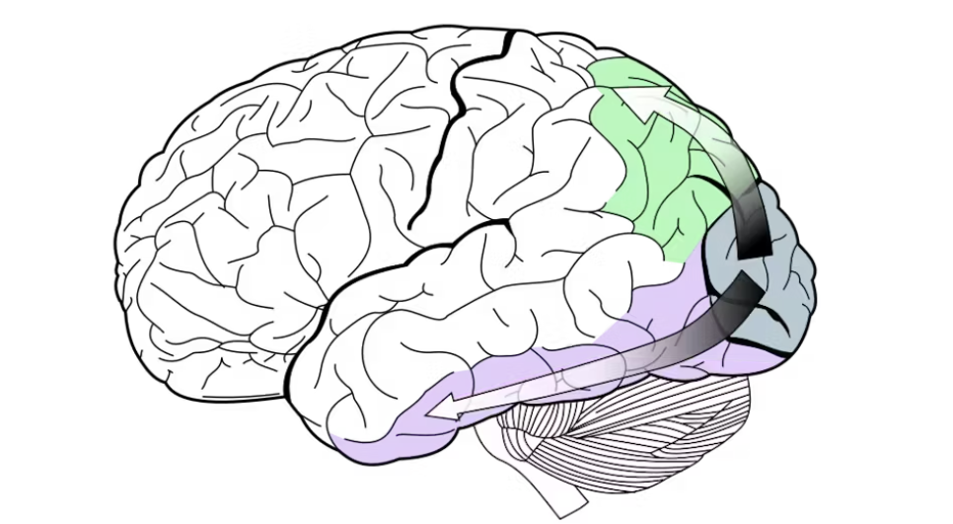
Waterfall Illusion in
Motion Perception
A repulsive perceptual bias where, after viewing motion in one direction for a while, a static or ambiguous stimulus appears to move in the opposite direction
Per-subject analysis of estimation bias, computed as the deviation between the current estimate and stimulus, relative to the circular mean of the previous 3 trials, across varying prior and coherence conditions

Slide 10
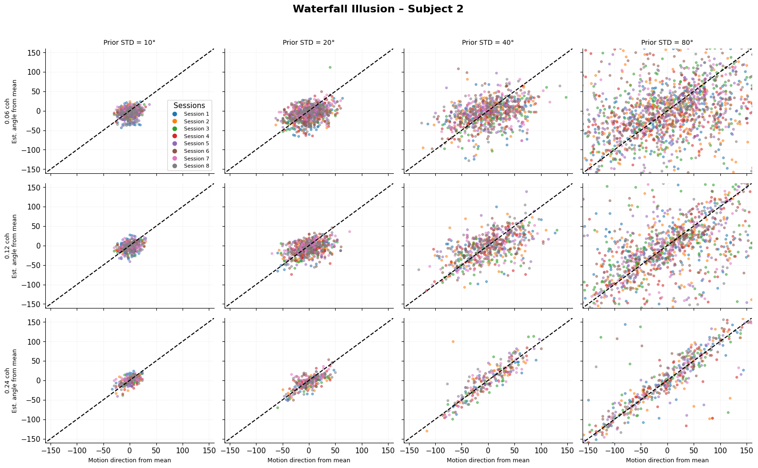
Subject 2
No clear evidence of the waterfall illusion. Estimates align with either the stimulus direction or the prior mean, showing no evidence of repulsion from recent motion history

Slide 11
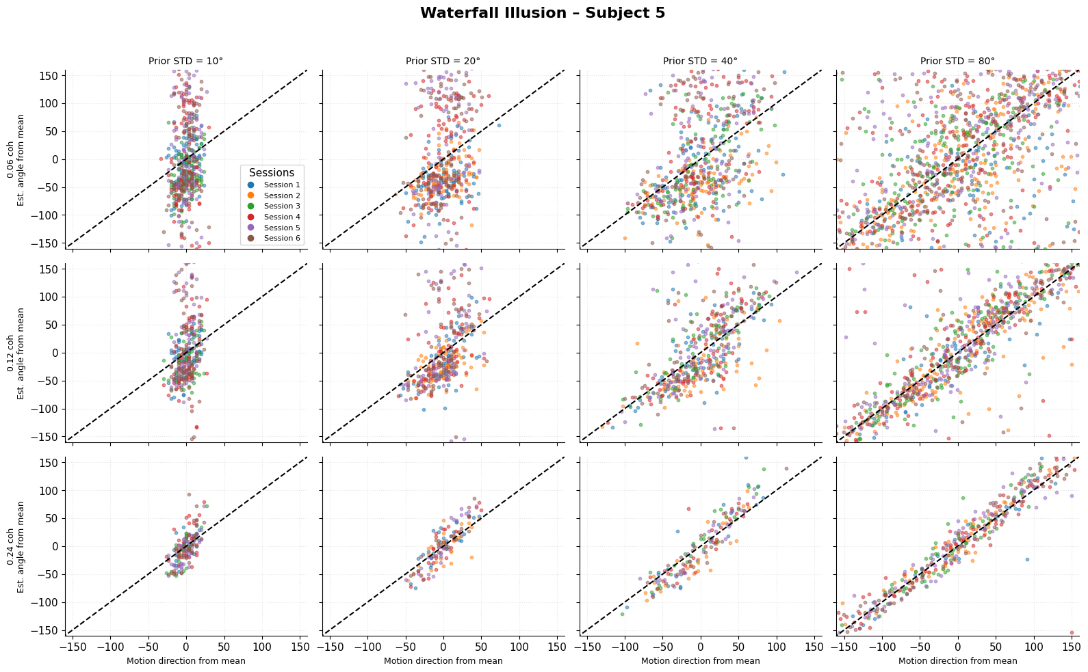
Subject 5
Evidence of the waterfall illusion, under low coherence and narrow prior conditions

Slide 12
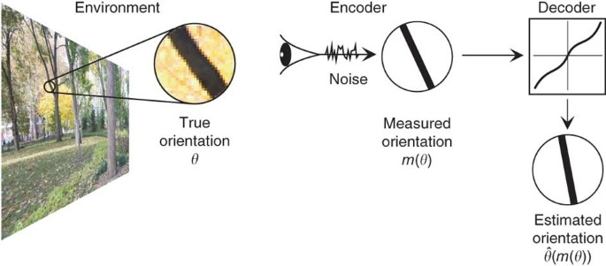
Cardinal Bias
Perceived orientations are attracted toward the cardinal directions, and repelled from the obliques.
Analyzed through difference between 2 halves for each slice of 45°

Slide 13
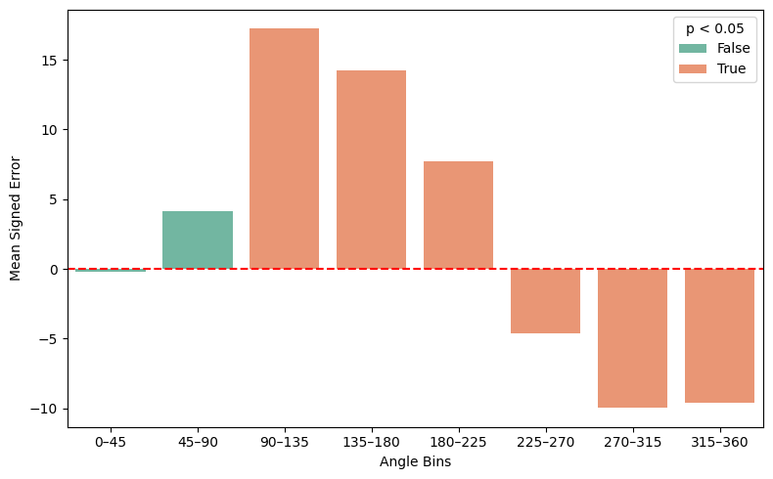
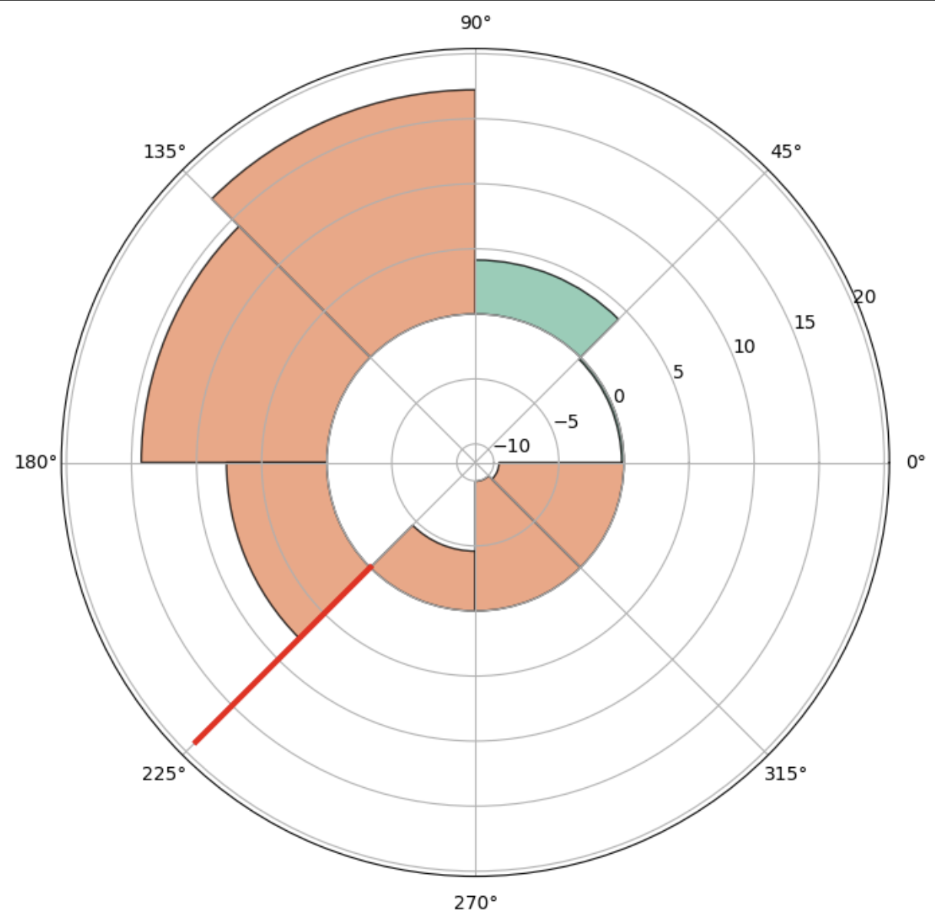
Attraction toward 225° prior

Slide 14
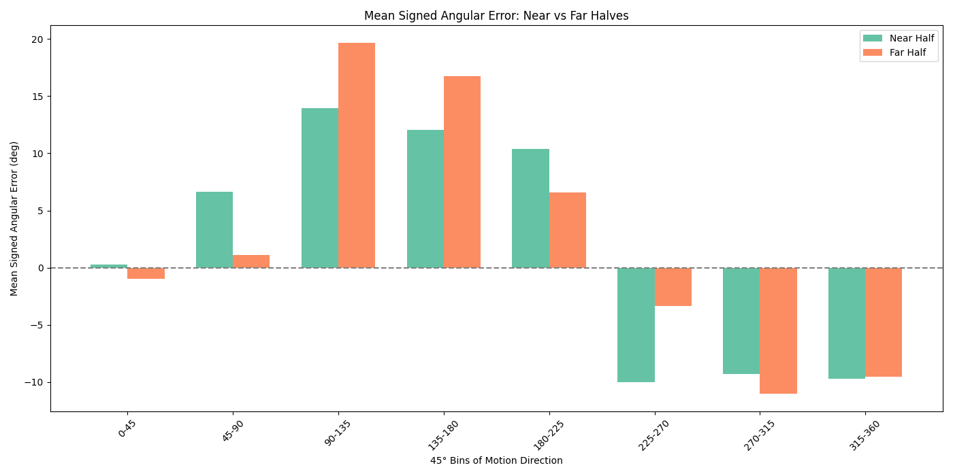
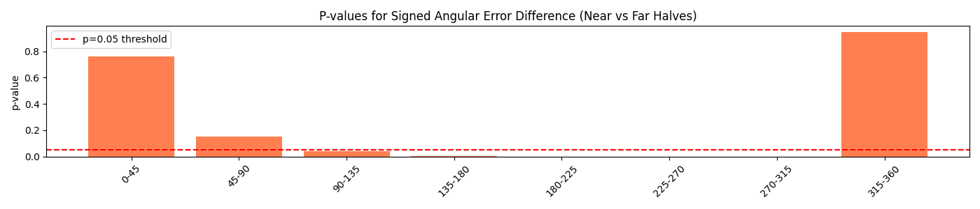
Half comparison

Slide 15
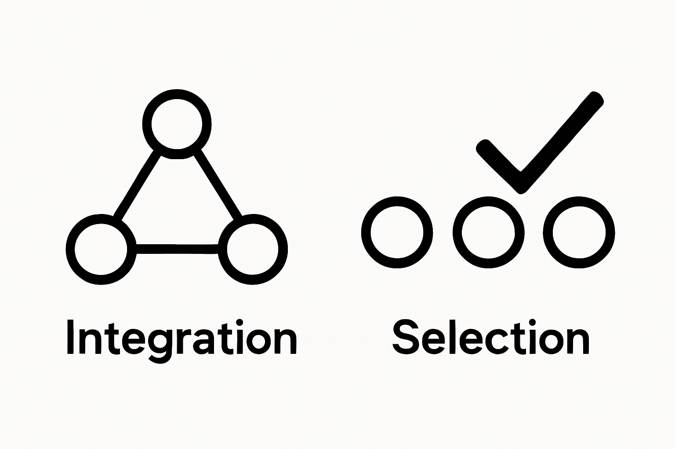
Modeling Perceptual Strategy: Bayesian vs. Switching
We test two competing theories by simulating "robot players" that try to mimic human behavior:
The Bayesian Observer: A "smart statistician" that optimally integrates all information.
The Switching Observer: A "mental shortcut" that chooses one source of information over another.
Which cognitive model best explains how we make decisions under uncertainty?

Slide 16
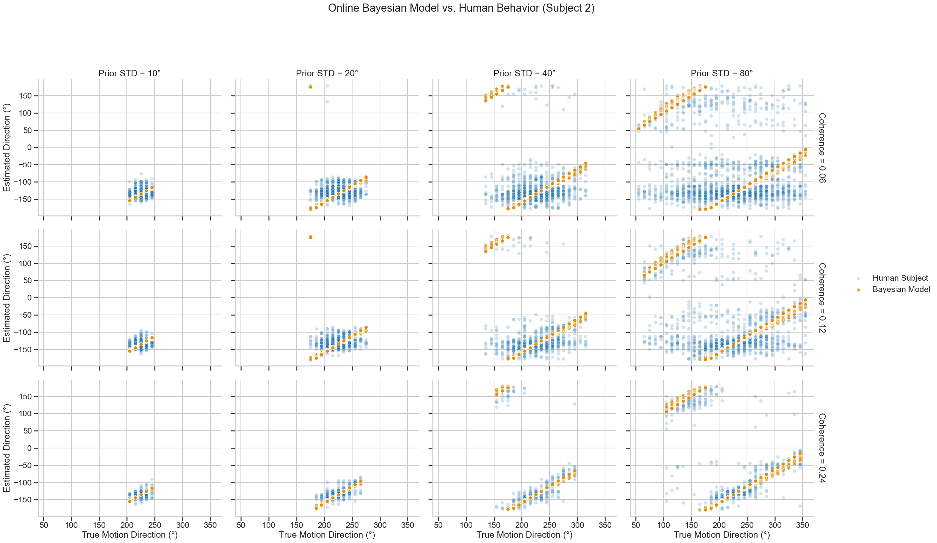
A Closer Look at the Bayesian Model
This model assumes the brain acts like an optimal statistician, combining what it sees (evidence) with what it expects (prior).
Its prediction is a weighted average of the two, and it learns by updating its confidence on every trial.
The plot shows the model's predictions (red) overlaid on the human's actual responses (blue) for our most interesting subject.

Slide 17
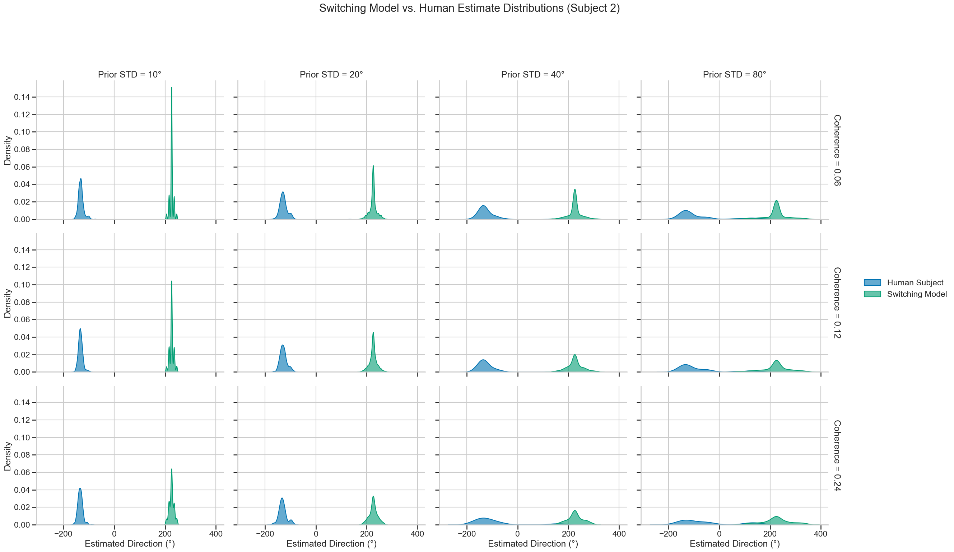
An Alternative Strategy: The Switching Model
This model proposes a simpler mental shortcut, or heuristic, instead of complex integration.
On each trial, it makes a probabilistic choice to report either the sensory evidence or the prior expectation.
Its key prediction is a two-peaked (bimodal) distribution of answers. The plot compares the shape of the model's predictions (red) to the human's (blue).

Slide 18
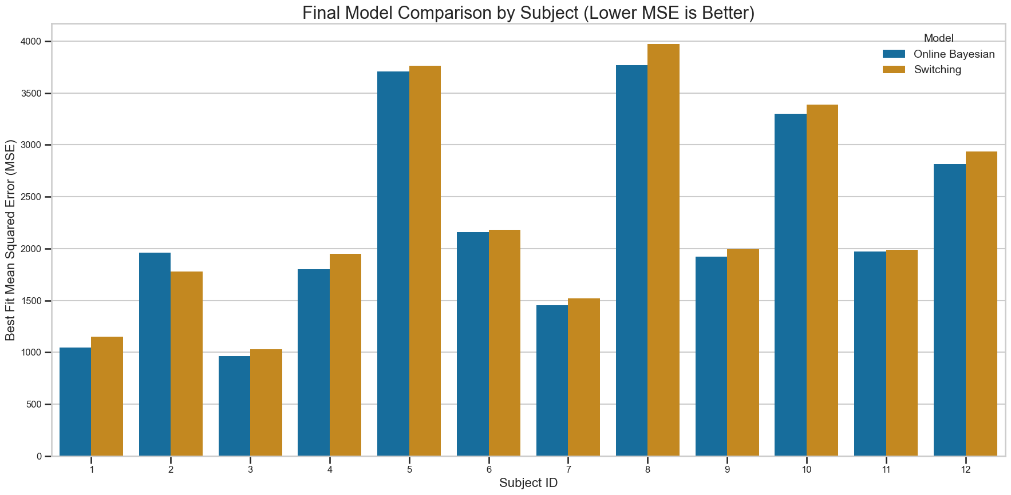
The Verdict: Bayesian Integration is a Better Fit
We ran a "bake-off," finding the best possible version of each model for all 12 subjects.
The Online Bayesian model consistently explained the human data better (lower error) for the vast majority of subjects.
However, the results also reveal profound individual differences, suggesting that while integration is a better general theory, the specific strategy is highly personal.

Slide 19
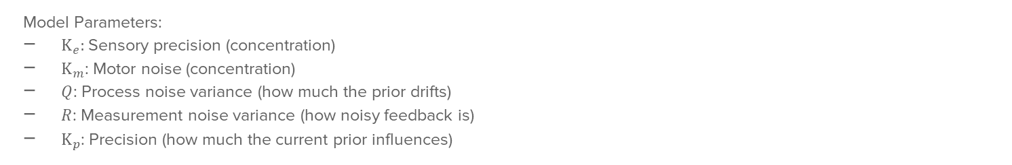
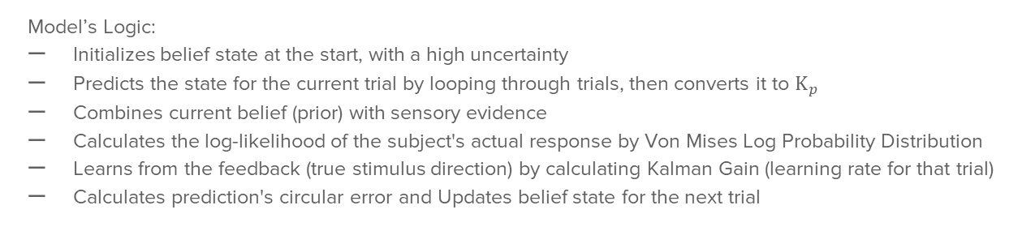
Online Bayesian Model with Kalmen Gain
Model Parameters:
$Κ_{e}:$Sensory precision (concentration)
$Κ_{m}$: Motor noise (concentration)
$Q$: Process noise variance (how much the prior drifts)
$R$: Measurement noise variance (how noisy feedback is)
$Κ_{p}$: Precision (how much the current prior influences)
Model’s Logic:
Initializes belief state at the start, with a high uncertainty
Predicts the state for the current trial by looping through trials, then converts it to $Κ_{p}$
Combines current belief (prior) with sensory evidence
Calculates the log-likelihood of the subject's actual response by Von Mises Log Probability Distribution
Learns from the feedback (true stimulus direction) by calculating Kalman Gain (learning rate for that trial)
Calculates prediction's circular error and Updates belief state for the next trial

Slide 20
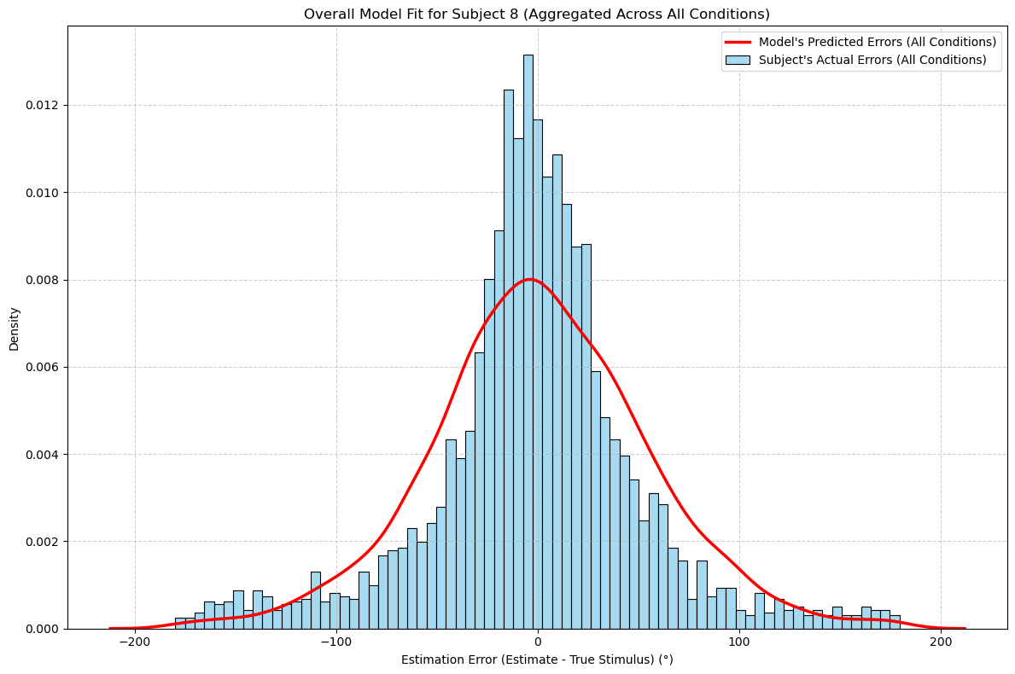
Model Fitting and Accuracy
The plot allows for a comparison between the actual errors (blue histogram) and the predicted errors (red curve).
A good fit would be indicated by the red curve aligning closely with the shape of the blue bars, suggesting that the model’s predictions closely match the actual subject’s data.
The actual errors seem to follow a distribution that peaks around zero, indicating that the model has a reasonable accuracy at the point of estimation, though there are outliers or deviations on both sides.
The model is capturing a general tendency of the errors but might be underestimating the variance, as the actual errors show more spread compared to the model’s predictions.

